Slide 1
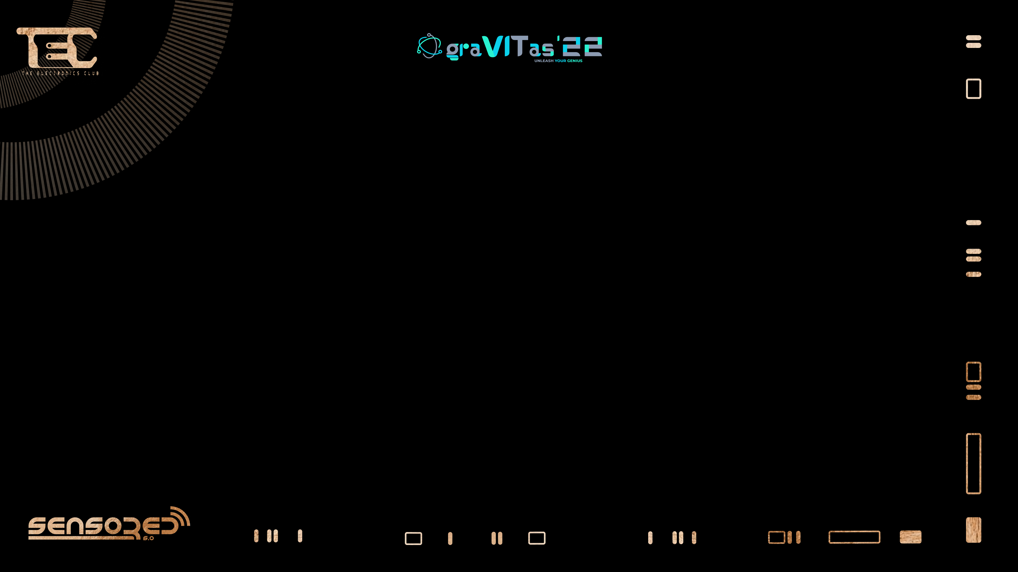

Arduino Basics

Slide 2
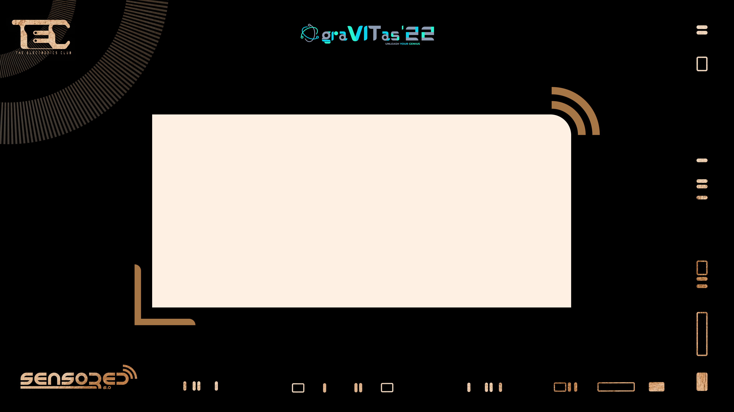


Slide 3
Development Board
Software AND hardware
Open source electronics platform
System to device communication

Slide 4
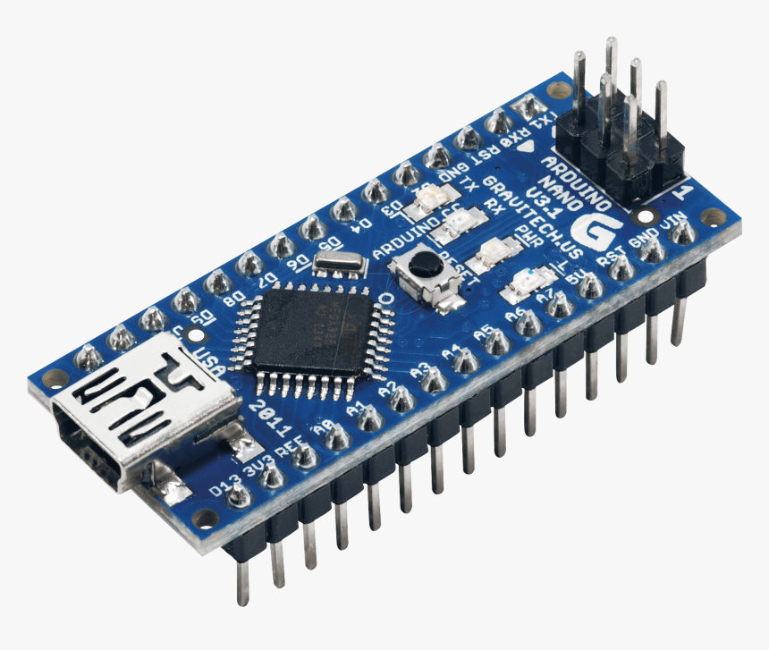
Development Board
Software AND hardware
Open source electronics platform
System to device communication
Arduino Nano

Slide 5


Slide 6
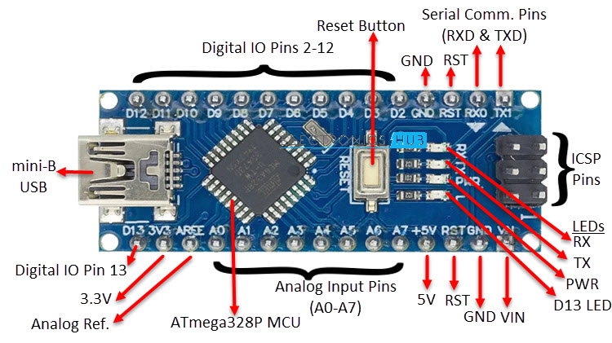
Arduino Nano
Arduino Nano

Slide 7
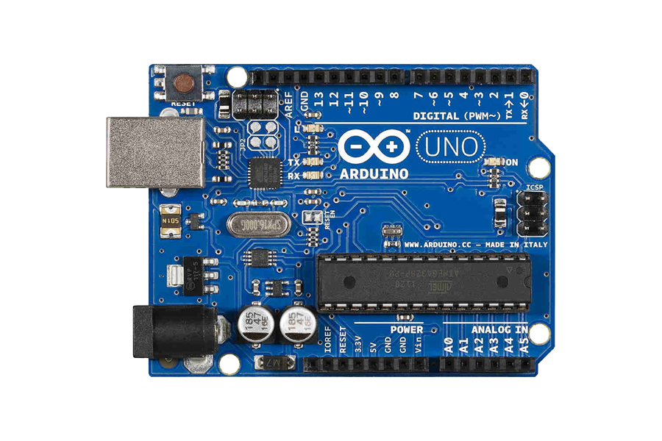
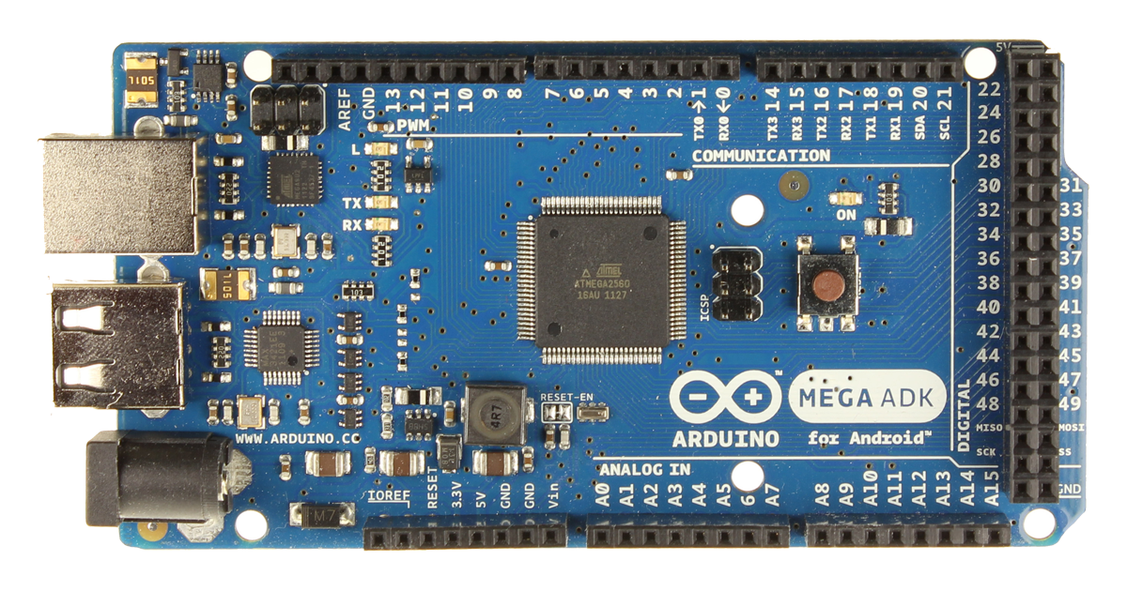
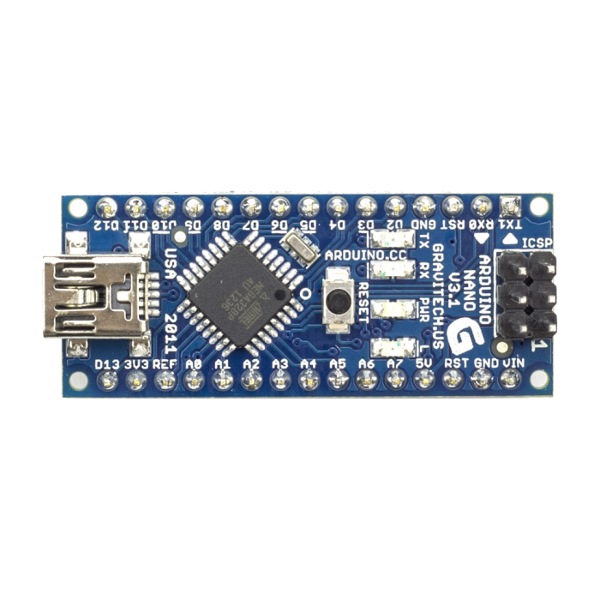
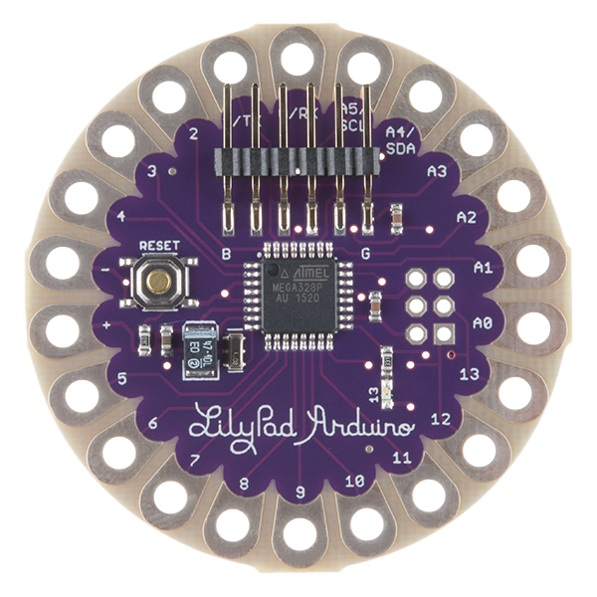
Various types of Arduino
Arduino UNO
Arduino MEGA
Arduino NANO
Arduino LILYPAD

Slide 8
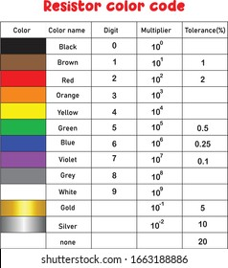
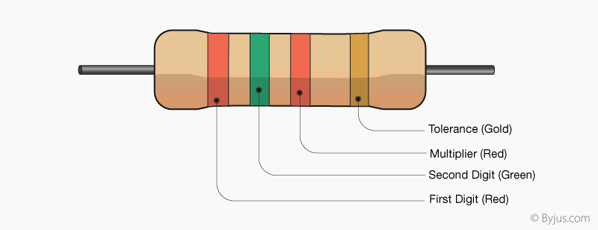
Color coding of Resistors
10² ±5%
25
ohms

Slide 9


Slide 10

HOW DOES IT COMMUNICATE WITH US?
Serial Communication

Slide 11


Slide 12
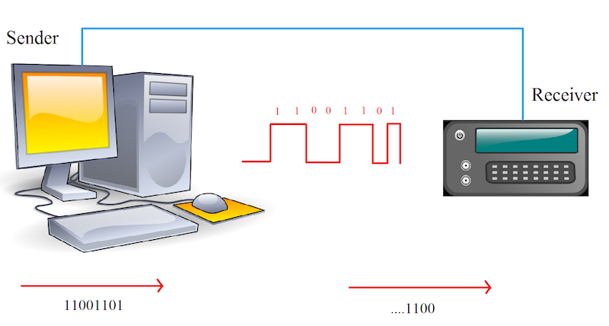
Arduino uses 3 protocols for its communication
UART Communication Protocol
2. SPI Communication Protocol
3. I2C Communication Protocol

Slide 13
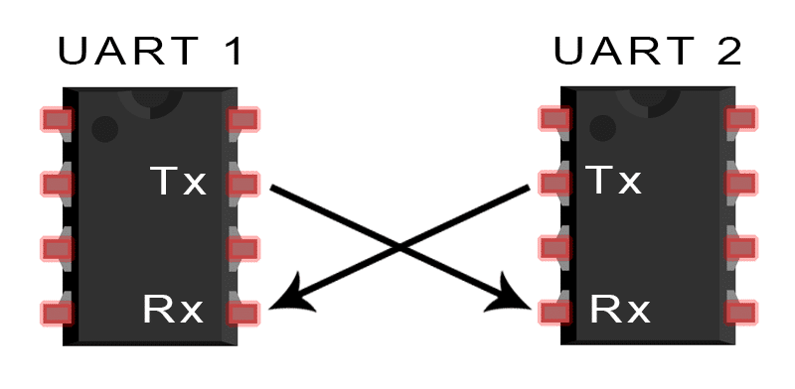
UART- Universal Asynchronous Receiver Transmitter
1. UART is a form of serial communication because data is transmitted as sequential bits. The wiring involved with setting up UART communication is very simple: one line for transmitting data (TX) and one line for receiving data (RX). As you may expect, the TX line is used to for the data to send device, and the RX line is used to receive data.

Slide 14
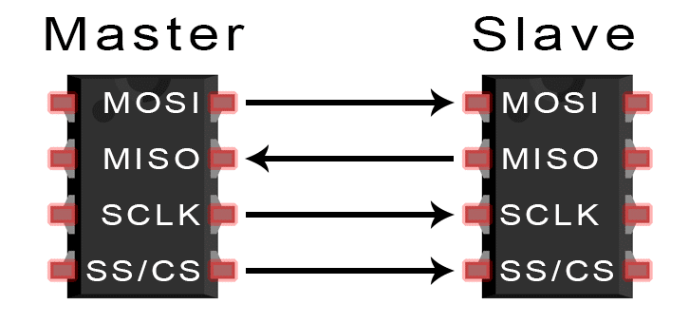
SPI- Serial Peripheral Interface
2. Devices communicating via SPI are in a master-slave relationship. The master is the controlling device (usually a microcontroller), while the slave (usually a sensor, display, or memory chip) takes instruction from the master.

Slide 15
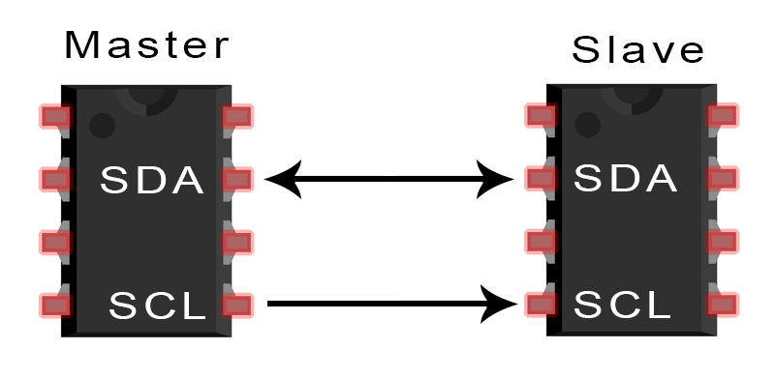
I2C- Inter Integrated Circuit
3. I2C addresses several drawbacks in the other communication protocols, giving it an advantage over the others in some applications. These include:
The ability to connect multiple masters to multiple slaves
Synchronicity (just like SPI), which means higher speed communication
Simplicity: implementation only requires two wires and some resistors

Slide 16


Slide 17


Slide 18

Arduino IDE v1.8

Slide 19
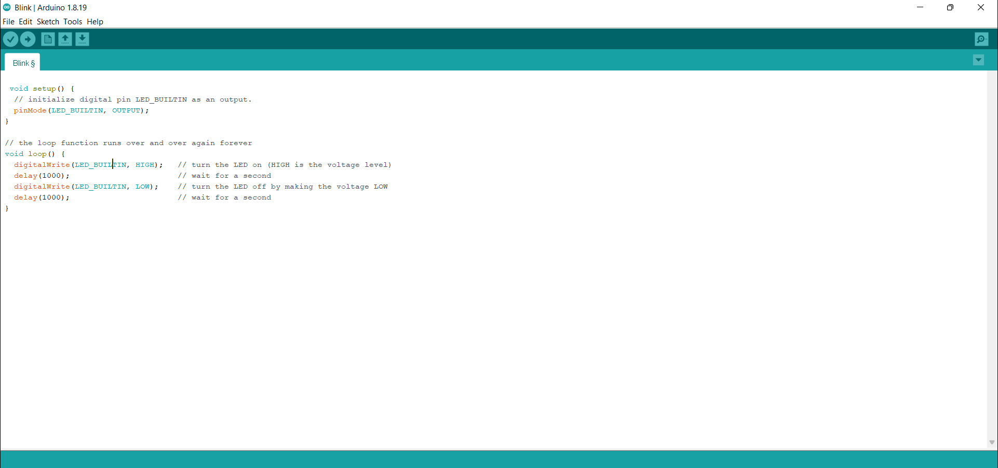
Serial Monitor
Upload to Board
Compile/Verify
New Sketch
Open .ino files
Save .ino files

Slide 20
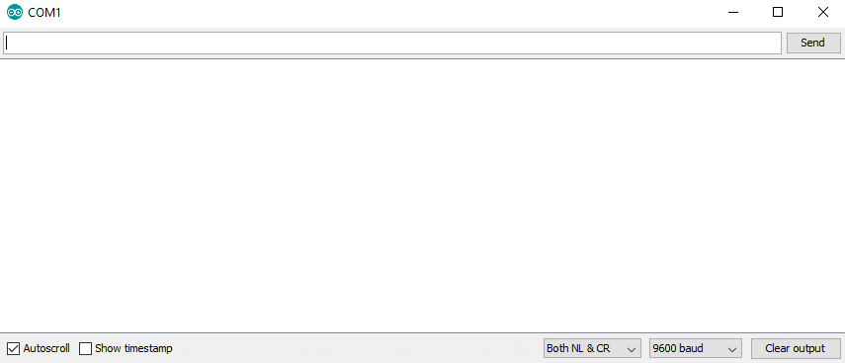

Serial Monitor

Slide 21

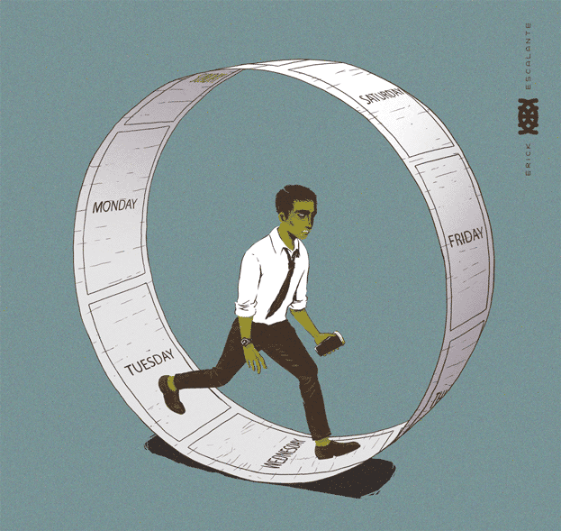
Did anyone notice what were the two parts of the code ???
VOID SETUP
VOID LOOP

Slide 22
Digital Input/Output
pinMode(pin, mode)
Sets pin to either INPUT or OUTPUT
digitalRead(pin)
Reads HIGH or LOW from a pin
digitalWrite(pin, value)
Writes HIGH or LOW to a pin

Slide 23
Analog Input
analogRead(pin)
Reads analog signal(value) from the pin and the ADC of the Arduino converts the value into digital format.

Slide 24


Slide 25
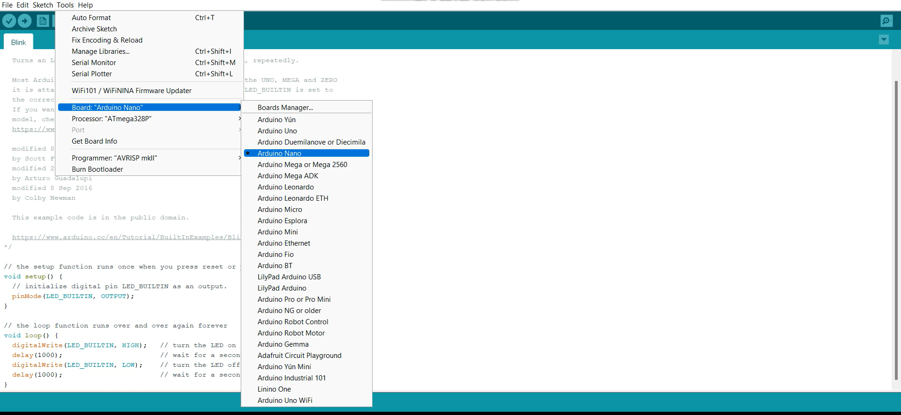
Connect the USB Cable to the Arduino and your system

Slide 26

How to resolve Port not showing in Arduino IDE
Try reconnecting your Arduino NANO to your system.
2. Try restarting the IDE.
3. If still the problem isn’t resolved yet, Don’t Panic! the driver must be missing and therefore Tech Support will install it in your system.

Slide 27
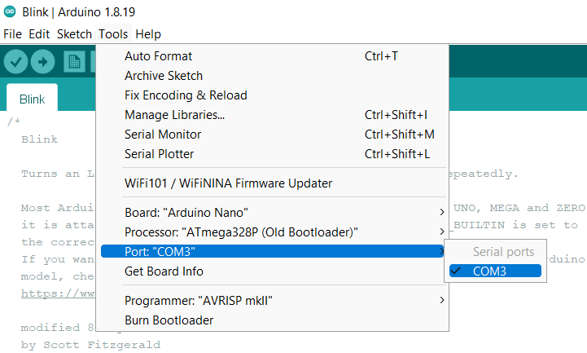
Select the Port to which you connected your Arduino nano

Slide 28
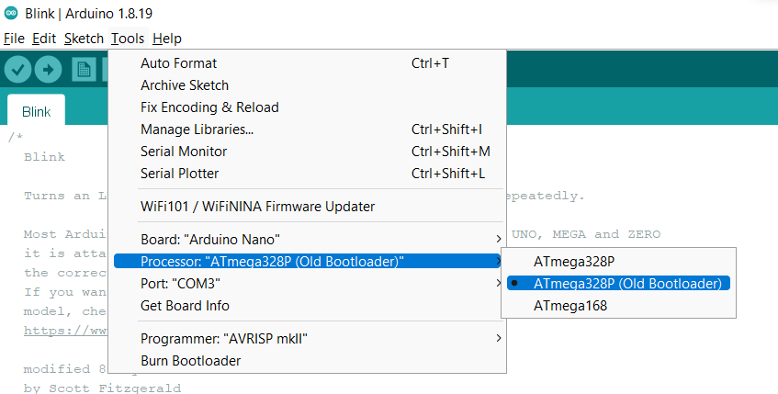
Select Processor as “ATmega328P (Old Bootloader)”

Slide 29
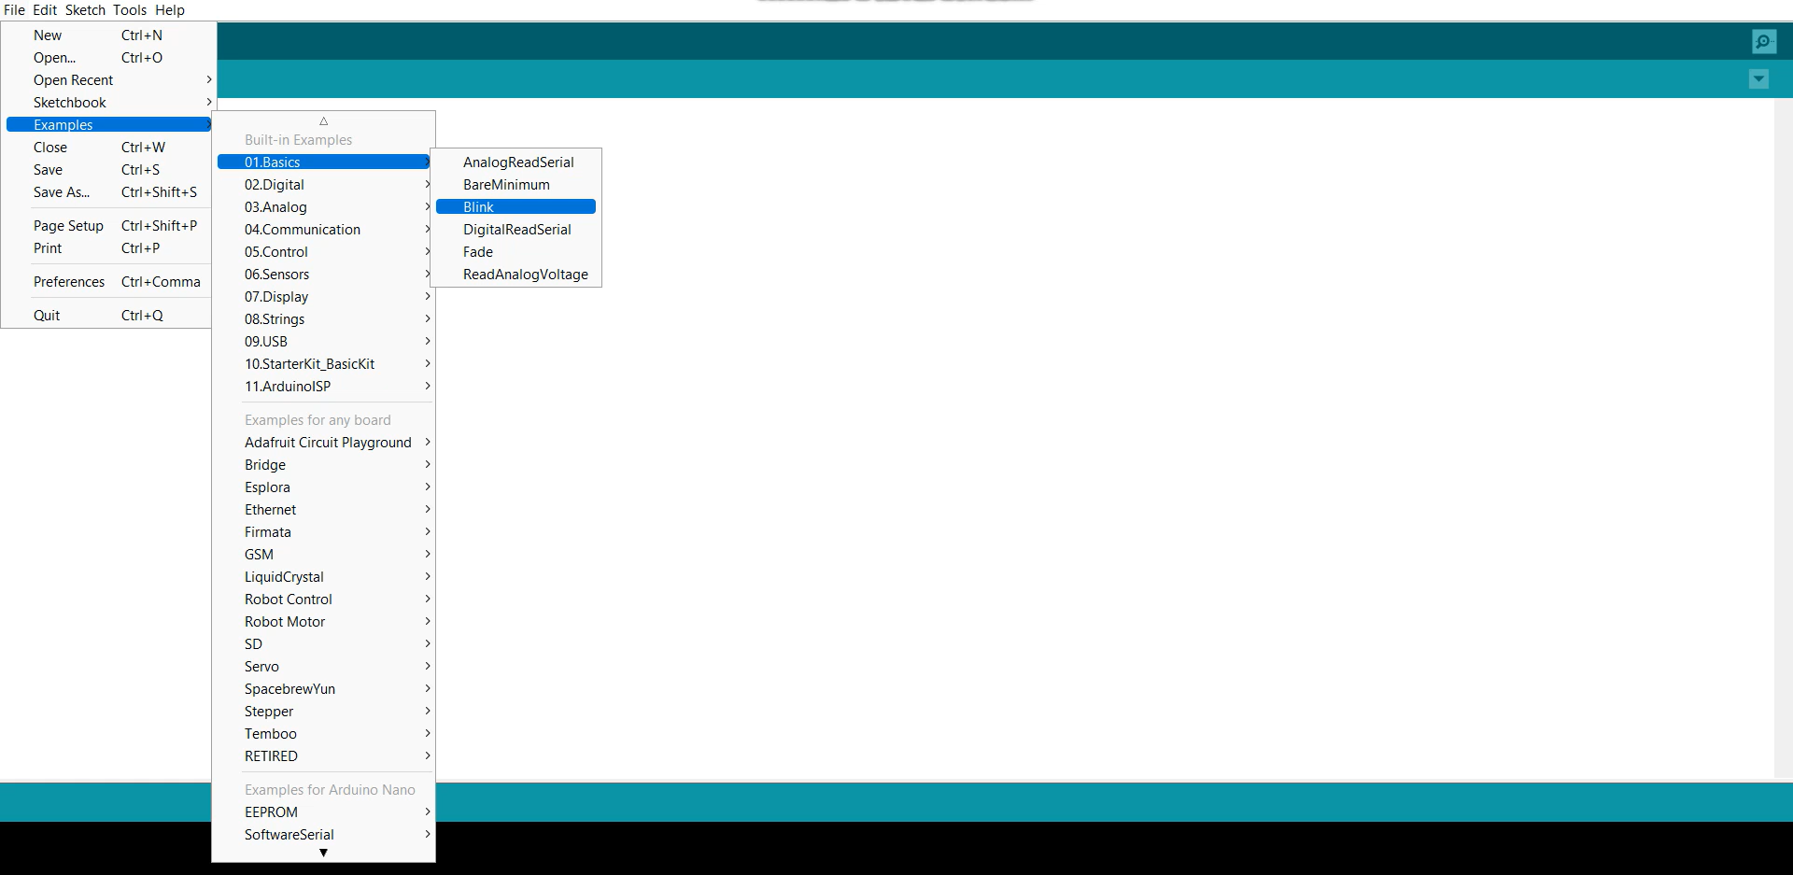
Now Let’s do our first program!!
EXAMPLES
BASICS
BLINK

Slide 30
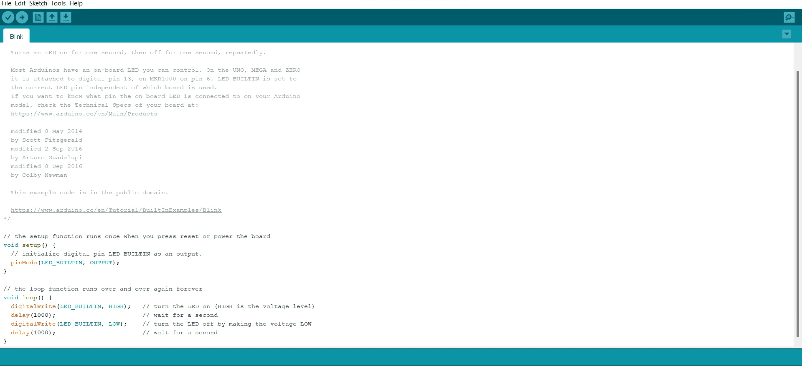


Slide 31
The Code
void setup() {
pinMode(LED_BUILTIN, OUTPUT);
}
void loop() {
digitalWrite(LED_BUILTIN, HIGH);
delay(500);
digitalWrite(LED_BUILTIN, LOW);
delay(500);
}

Slide 32
Upload your code

Slide 33

LED Blinking using Arduino Minion

Slide 34
BLINK

Slide 35

Speakers : Astha Tiwari
Aditya Kamboj

